Slide 1


Where Brains Meet Buzzer Skills—and Coffee Fuels the Courage!

Slide 2

"Education is not the filling of a pail, but the lighting of a fire."
— William Butler Yeats

Slide 3

Final Jeopardy
Effective Teaching Practices

Slide 4


Question:
This two-word phrase describes a teaching approach where educators act as facilitators, guiding students to construct their own understanding through inquiry, collaboration, and active participation.
Answer: What is student-centered?

Slide 5
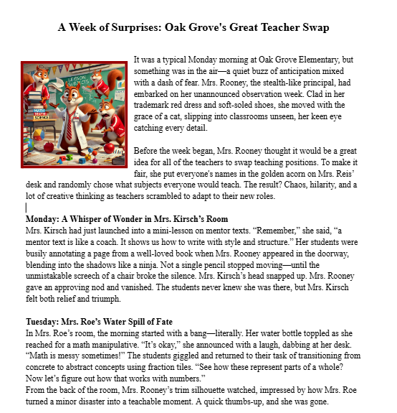
click on article

Slide 6
AI slide by Angie

Slide 7
